Slide 1
Feasibility of Team Training in Virtual Reality for RAMIS
20th Dec 2017
*Niclas Hjorth Stjernholm
*Oliver Gyldenberg Hjermitslev
Nicklas Haagh Christensen
Atanas Atanasov Nikolov
Frederik Falk

Slide 2

Contents
RAMIS - Introduction and Importance
Context Study
Team Training in Virtual Reality
Methods
Results
Discussion and Conclusion

Slide 3
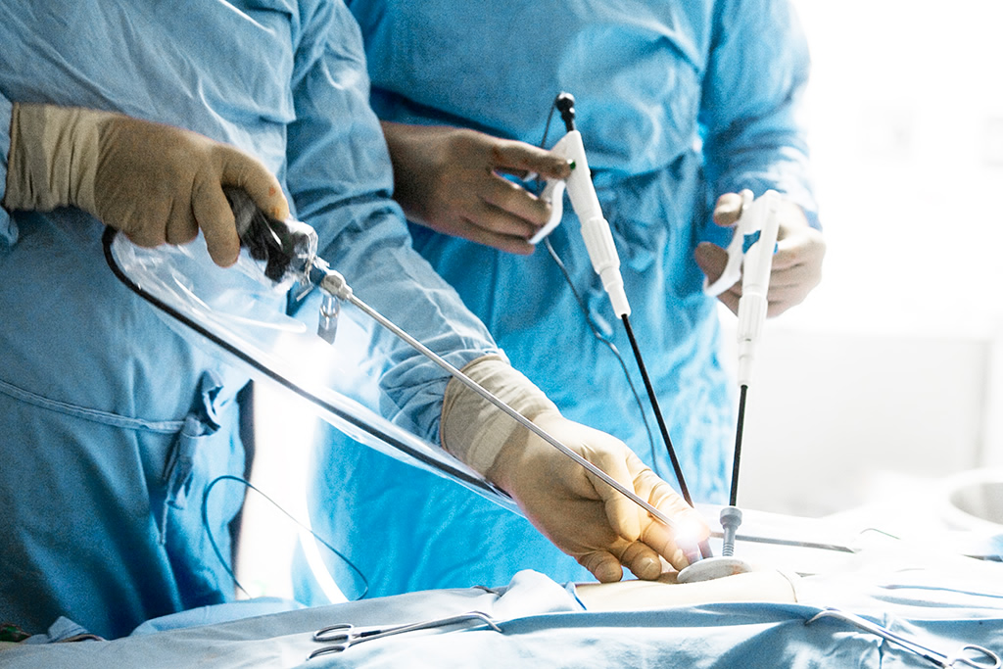
Introduction to Minimally Invasive Surgery
Small incisions
Reduced recovery time
Lower risk of injury
Requires laparoscopic tools

Slide 4
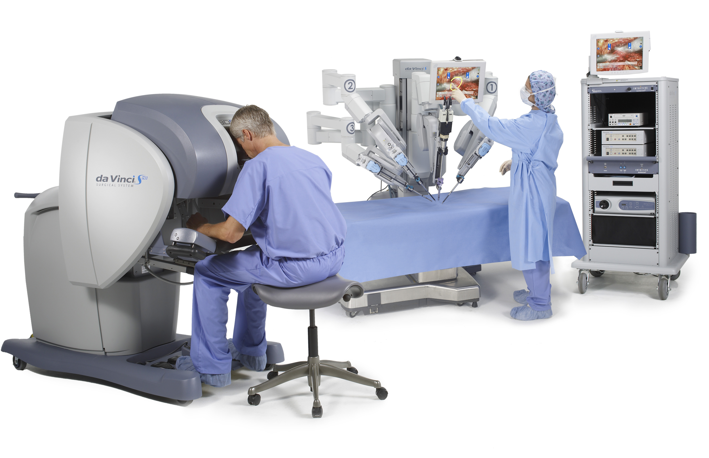
Robot Assisted Minimally Invasive Surgery
Controlled by a specialized surgeon
Surgeon operates from console
Controls multiple tools and an endoscopic camera
Nurses handle the robot and assist from outside the patient
We collaborated with MIUC on team training for RAMIS

Slide 5
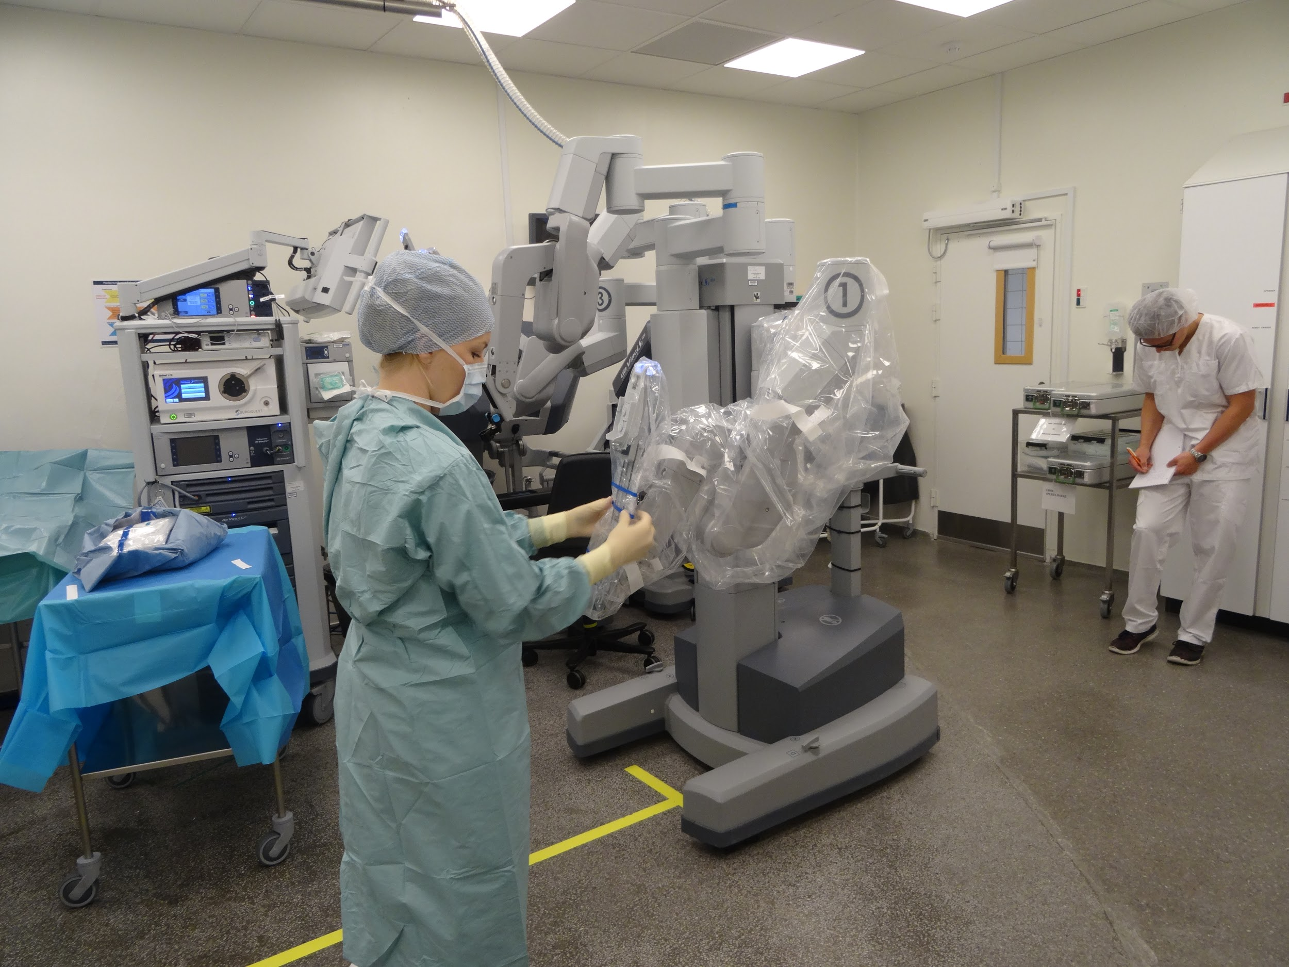
Team Training for RAMIS
RAMIS requires specialised teams to operate
Teamwork is an essential competency¹
Few centres
Expensive and time-consuming
To reduce critical events, simulation-based training has become increasingly popular²
¹E. Salas et al. http://journals.sagepub.com/doi/10.1518/001872008X375009
²R. Aggarwal, doi: 10.1136/qshc.2004.010009

Slide 6
Hypothesis:
VR can simulate Team Training with sufficient accuracy, thereby increasing accessibility

Slide 7
Context Study
5 interviews
3 training observations
1 surgery observation
Contextual Inquiry
Key training and operation procedures
Emergency Simulation
Error Handling and Troubleshooting
Standard procedures (docking, undocking)
Communication
Verbal, both trainee-trainee and trainee-instructor
May be visual using monitors or body-language, examples
Unspoken (implicit) communication
Roles
Notes:
Models will be used later :)

Slide 8
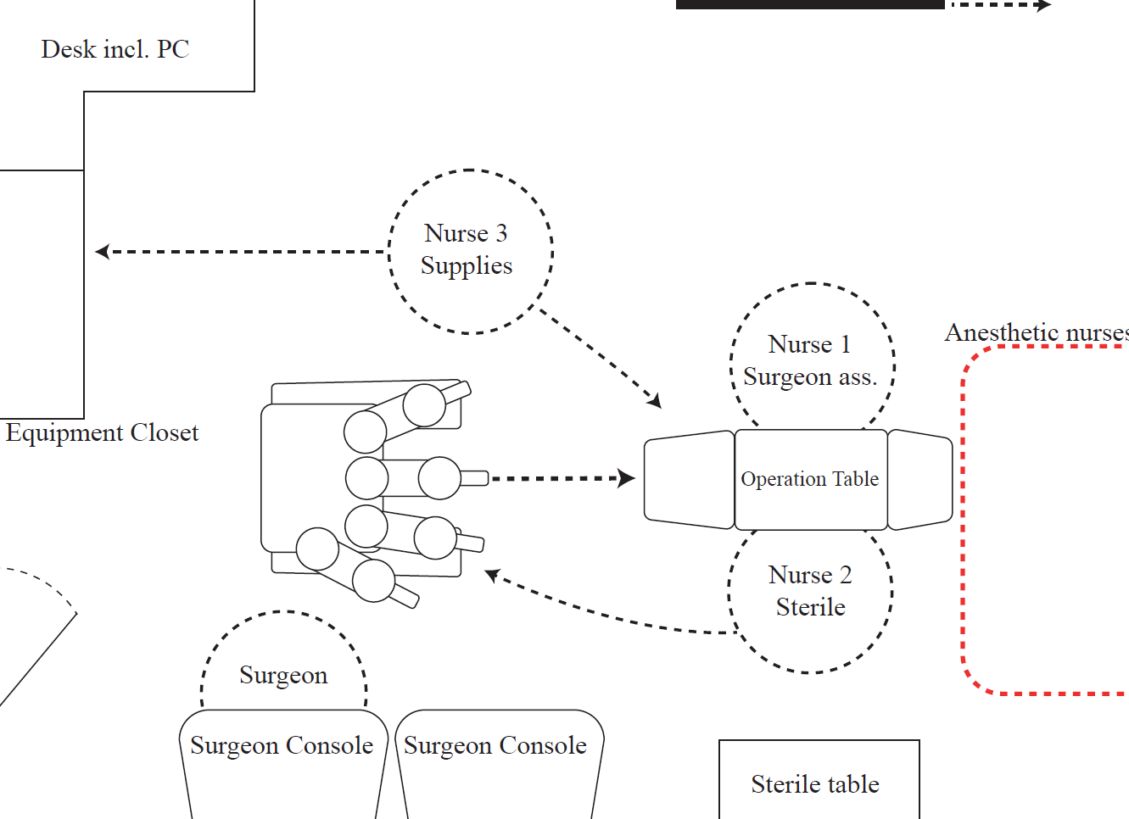
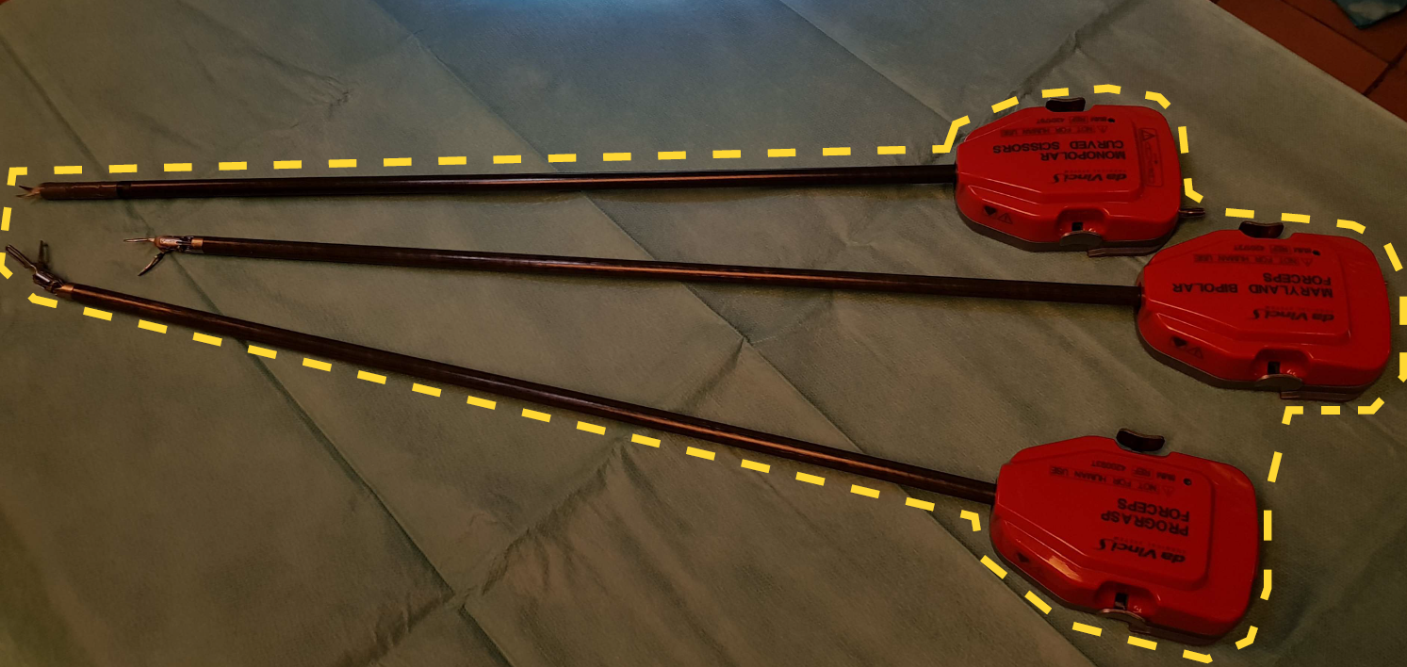
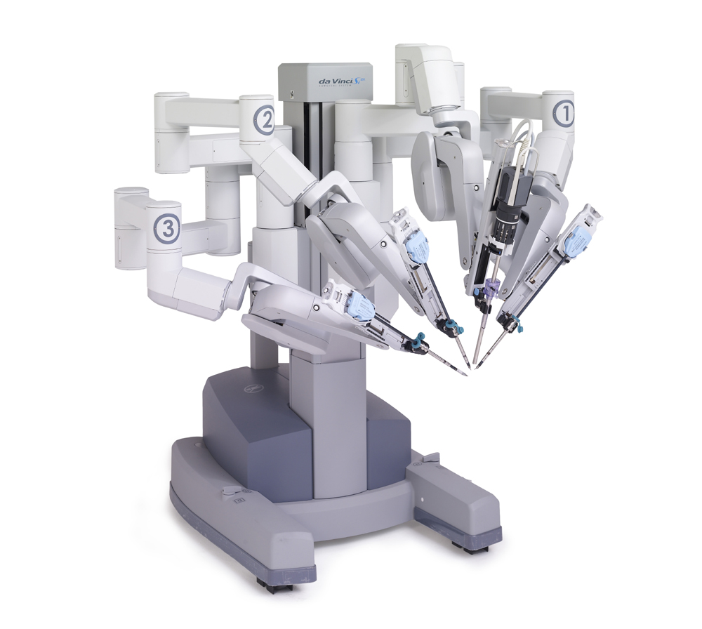
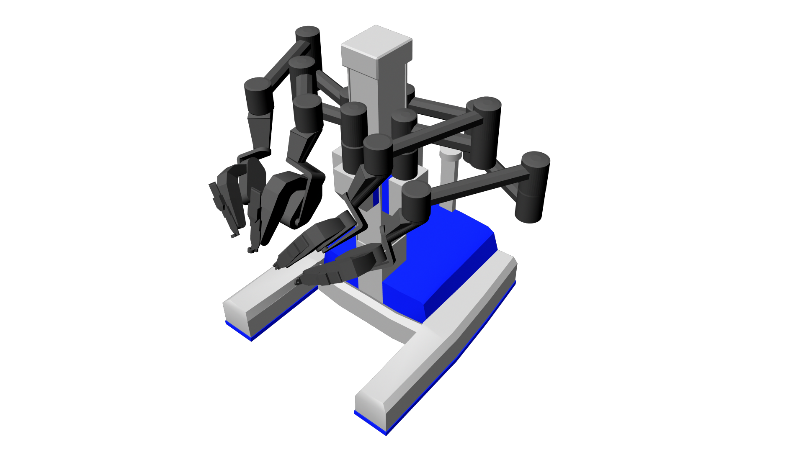
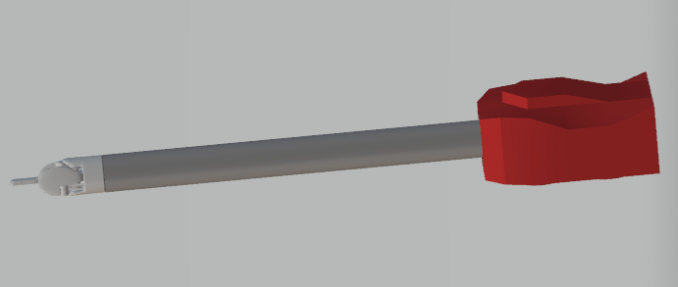
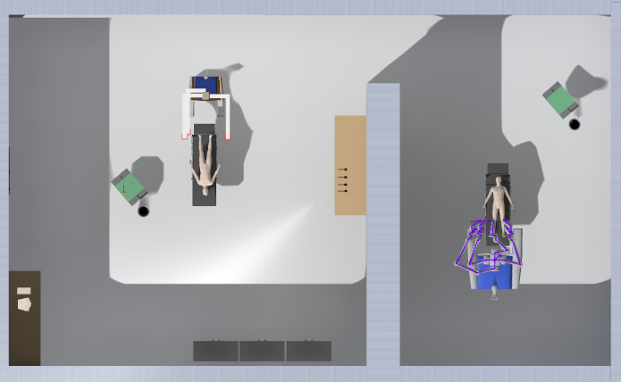
Implementing Team Training in Virtual Reality
Use the physical model to create the scene
Use the artifact model to decide which objects to implement
Use the sequence model to evaluate - which scenarios are possible?
Used Proteus in Unreal Engine 4
Communication is possible with VoIP

Slide 9
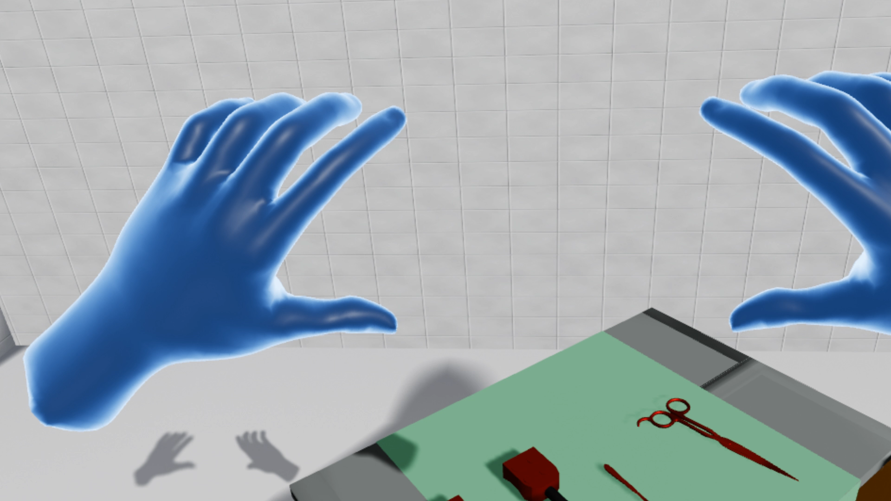
Example use in the Scene

Slide 10
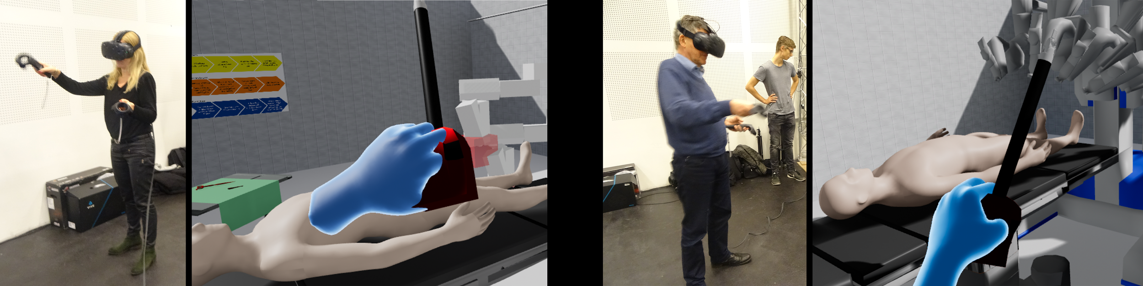
Testing Methodology
Expert Review with
Jane Petersson, first nurse assistant and nurse specialist in robot surgery
Johan Poulsen, head surgeon of robot surgery at Aalborg University Hospital
Introduced to VR with a training scene
Evaluated our scene
Introduced to VR with a training scene
Evaluated our scene afterwards

Slide 11
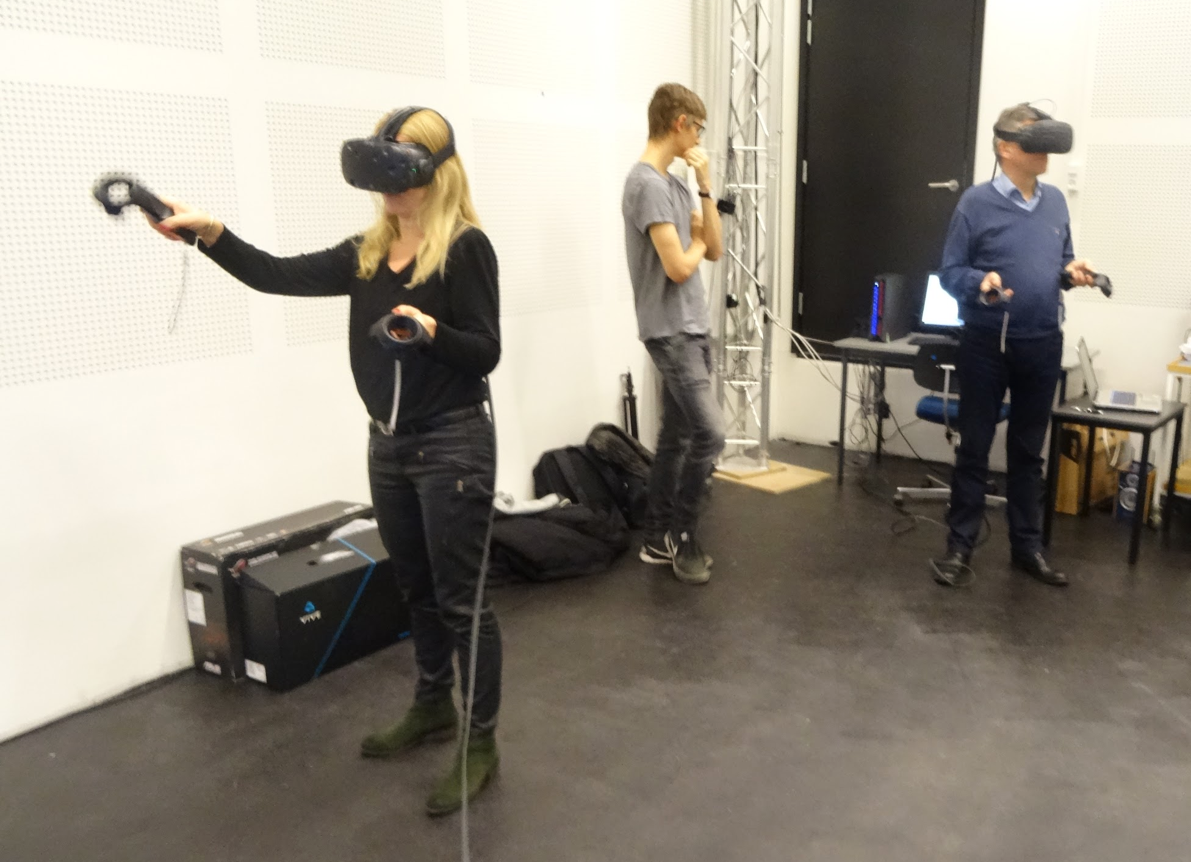
Results - Proof of Concept
The system is not complete enough to warrant implementation at this stage
VR can provide sufficient accuracy for team training
Realism is extremely important
Scenarios
Surgical staff is used to compensating for lack of tactile feedback with visuals
Experts agreed that VR training could be crucial to improving RAMIS training accessibility
Notes:
Scenarios with/without instructor

Slide 12
Hypothesis:
VR can simulate Team Training with sufficient accuracy, thereby increasing accessibility

Slide 13
It seems so :)
According to experts

Slide 14

Discussion
Combining simulations
Realism, trade-off with computational efficiency
Single-player to learn multiple roles
We suggest
Development of full system, including a comparison of inverse kinematic methods
Usability test of full system
Longitudinal study to determine the effects of using VR in team training for RAMIS

Slide 15
Acknowledgements
Thanks to Jane Petersson and Johan Poulsen at the MIUC department on Aalborg University Hospital for participation and engagement in the project and for letting us observe training sessions as well as an operation.

